Slide 1


OM 621 — Transportation Analytics (Assignments 2 & 3)
Brenda Laime Jalil · Advanced Visual Analytics · Fall 2025

Slide 2
Why this matters — Problem & Stakeholders
Invoices can lag weeks to months after shipments.
Stakeholders: Director of Supply Chain, finance, ops analysts.
Goal: understand WHEN invoices land and HOW costs move.

Slide 3
My Questions
Are invoice delays different by transportation mode?
Do invoice amounts show trend/seasonality for forecasting?
What rules stabilize accruals and monthly expectations?

Slide 4
Data & Setup
Dataset (2022–2024)
site, mode, region, destination
shipping_date, invoice_date
usda_invoice_amount (USD)
Processing
Parsed dates; delay = invoice − ship (days)
Fixed typo: parcel_grund → parcel_ground
Human‑readable mode labels

Slide 5
Method
Explore
Explore delay distributions by region/site/mode.
Aggregate
Aggregate invoices monthly; lines grouped by year; facet by mode.
Refine
Refine visuals and save PNGs for re‑use.

Slide 6
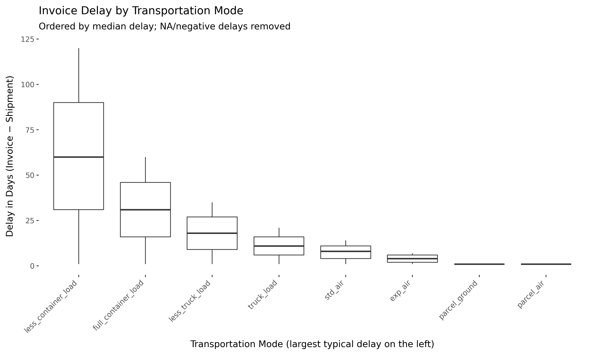
Key Visual #1 — Delay by Mode (ordered boxplot)
Insert: delay_dist_by_mode.png (containers slower + wider tails).

Slide 7
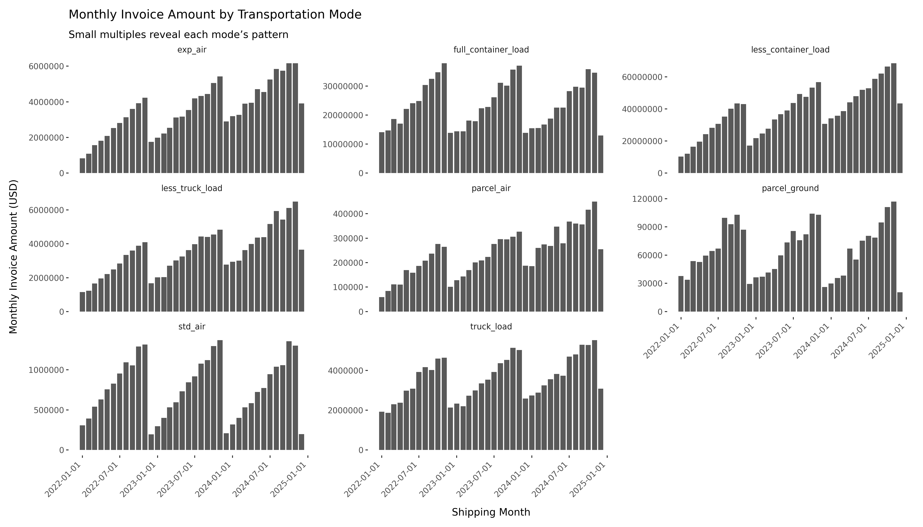
Key Visual #2 — Invoice Time Series by Mode

Slide 8
Findings → Action
Findings
Right‑skewed delays; mode is key.
Containers trend upward; parcel/air flatter.
Actions
Accruals: median delay by mode + buffer for containers.
Forecast per‑mode (seasonal month baseline + recent trend).
Sum mode forecasts to total; monitor outliers.

Slide 9
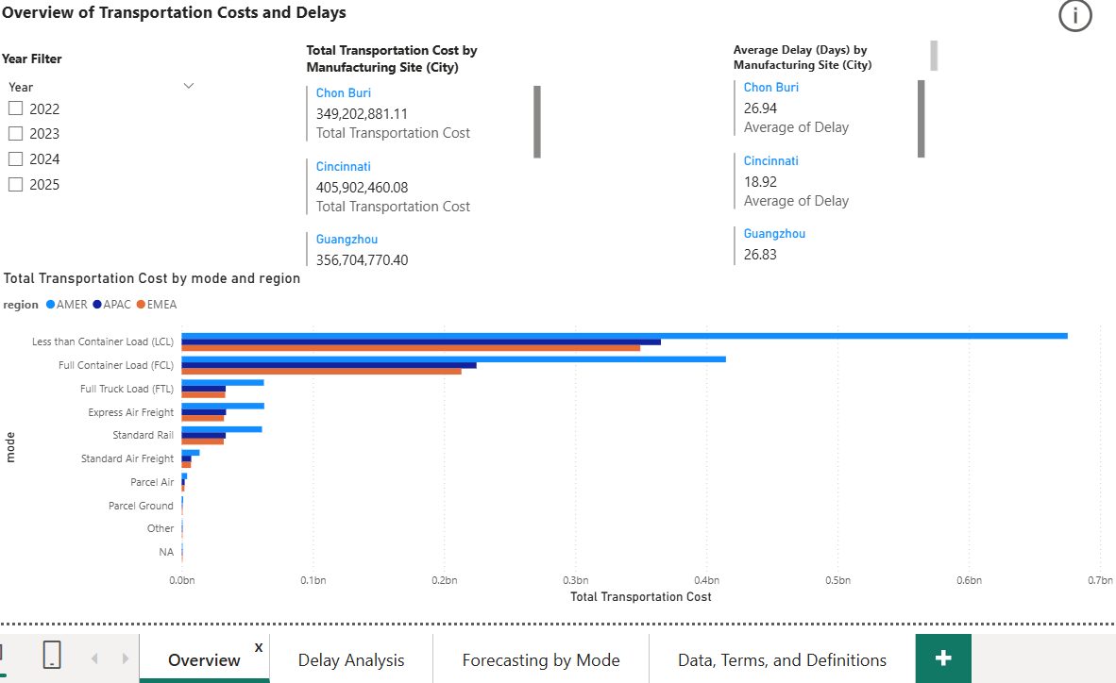
Power BI

Slide 10
What’s next
Data to add
Carrier, contract terms
Holiday/port calendars
Operationalize
Alert when predicted delay > 45 days
Automate monthly pipeline

Slide 11
Links
GitHub: github.com/Brendalaime/om621_assignments
Portfolio: brendalaime.github.io/om621-assignments/
Notebook: notebooks/OM621_A2_A3_Combined.ipynb
PBIX: pbi/OM621_Assignment4.pbix

Slide 12
Thanks!
Happy to open the notebook or dashboard for Q&A.

